Slide 1
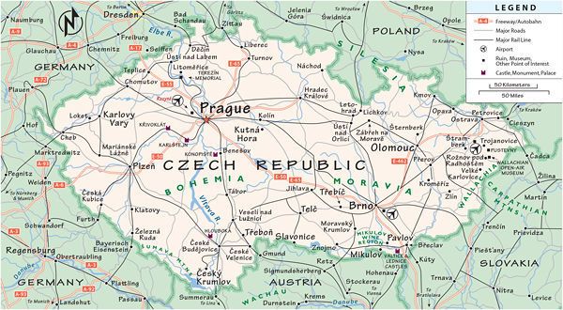

Czech national recipes

Slide 2
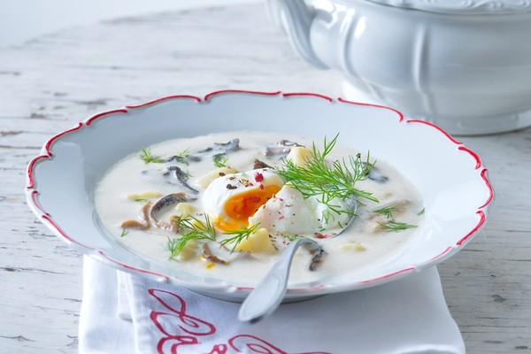
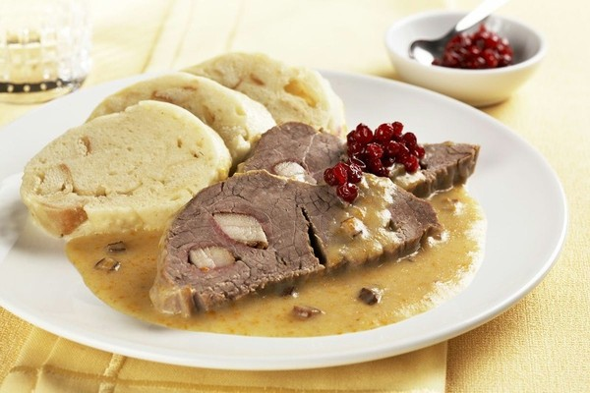
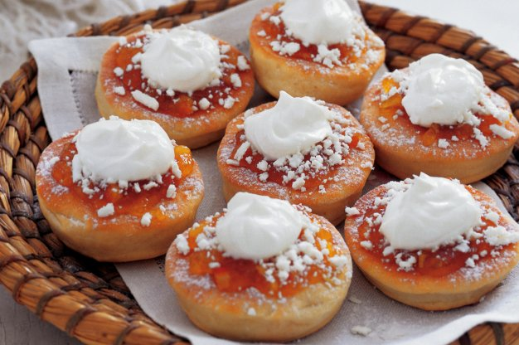
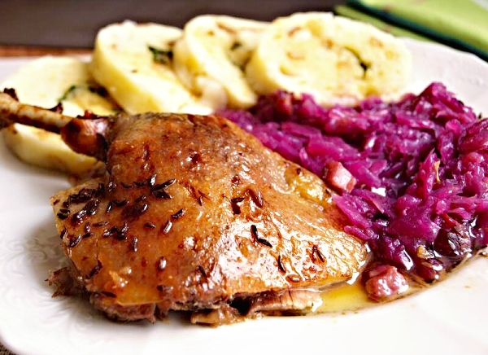
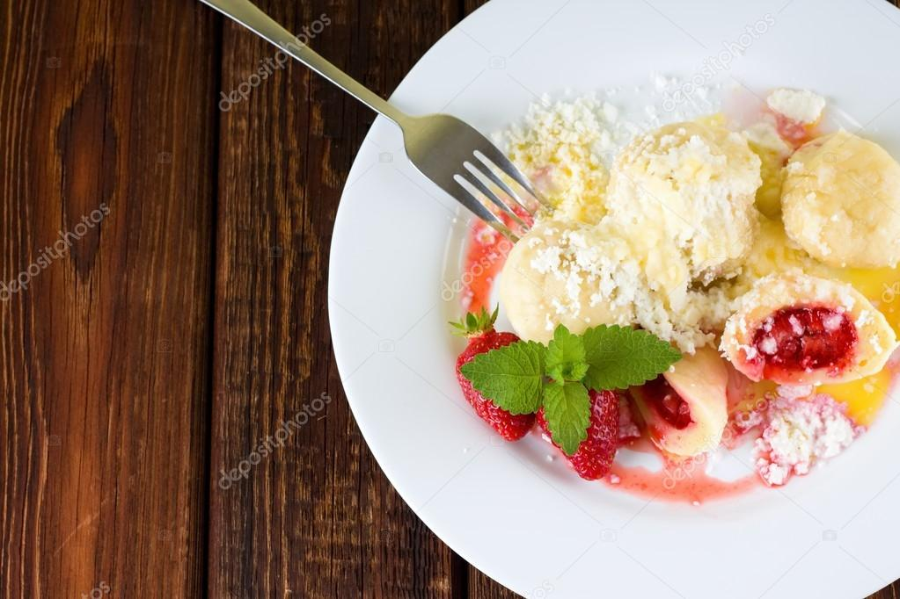
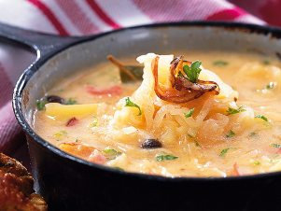

Slide 3
Kulajda soup with poached eggs

Slide 4
Ingredients
dried or fresh mushrooms
50 g butter
2 tablespoons of flour (finely ground)
800 ml water
250 g potatoes
salt, white pepper
200 ml sour cream or cream for whipping
50 g butter for diluting
1 twig fresh dill or
2 tablespoons of dill
4 eggs
vinegar
Kulajda soup

Slide 5
Direction
Soak dried mushrooms for at least one hour, ideally overnight.
Mix butter and flour to prepare roux, mix evenly while pouring water.
Clean the potatoes and cut them in cubes, add them to the soup, together with mushrooms (and with the water they were soaked). Sprinkle with salt, pepper and cook until mushrooms and potatoes get tender, about 15‑20 minutes.
UČEBNA STOLNIČENÍ
IT UČEBNA
JAZYKOV
CVIČNÁ KUCHYŇ
INTERAKTIVNÍ UČEBNA
Kulajda soup

Slide 6
Direction
In the meantime, prepare poached eggs. Bring salty and mildly acid water nearly to boil, whirl and by means of a ladle put in one beaten egg, cook for about 4‑5 minutes, take out and repeat with another egg. Put one egg in each serving. When the soup is nearly ready, pour in season with vinegar, add butter and chopped dill.
Kulajda soup

Slide 7
Sauerkraut soup

Slide 8
Ingredients
1 bag sauerkraut, rinsed
4-6 large potatoes, cubed
1 large spicy kielbasa, sliced
1 large onion
3 Tbsp. butter
1 cup sour cream
¼ cup milk
¼ cup flour
Bay leaf
8 balls of allspice
1 tsp. caraway seeds
Handful of Czech dried mushrooms
sugar, salt & pepper to taste
lemon or vinegar to taste
Sauerkraut soup

Slide 9
Direction
Roughly chop and place the dried mushrooms in a bowl and cover with boiling water, set aside.
Rinse the sauerkraut and chop into smaller pieces. Put into a large saucepan with caraway and 2 cups of water and boil on medium heat until tender.
In a large soup pot fry the chopped onion for 8 minutes on medium heat. Then add and fry the sliced sausages for 8 minutes more.
Strain and squeeze any moisture out of the mushrooms and add them to the pot. Add the allspice, bay leaves and 2 quarts of water (8 cups). Cook for 10 minutes.
Add rinsed diced/cubed potatoes and cook for 20 minutes allowing potatoes to cook.
Sauerkraut soup

Slide 10



Healthy EU

Slide 11
Direction
Remove the bay leaves and floating allspice.
Add the sauerkraut to the soup pot (with any remaining liquid).
Empty the sour cream into a bowl and add milk and flour. Also add two ladles of liquid from the soup and whisk to break up all flour.
Slowly pour into the soup mixture, stirring to incorporate.
Cook on low for 15 more minutes, allowing the soup to thicken and then adjust to taste, adding sugar, salt, pepper and a splash of vinegar or lemon to taste to balance the sweet and sour taste as desired.
Pour into bowls and garnish with any of the following; parsley, dollop of sour cream, crumbled cooked bacon or fresh dill.
Serve with bread, rolls or rohliky
Sauerkraut soup

Slide 12
Roast duck with sauerkraut and dumplings

Slide 13
Ingredients
1 - 5 pound duck
3 teaspoons caraway seeds
1 clove garlic, minced
Salt/Pepper
1 cup water
2 packs of sauerkraut
dumplings
Roast duck with sauerkraut and dumplings

Slide 14
Direction
Clean and rinse duck inside and outside cavity
Pat dry duck
Pierce fatty sections of duck with fork
Coat inside and outside of duck with combination of salt, garlic, and caraway seeds
Place duck breast side down on roasting pan
Pour cup of water into base of roasting pan
Place pan into 350 degree oven and roast for one hour covered
After first hour flip duck over, rebaste with juices and fat gathered on bottom of pan and roast for additional hour
Allow duck to rest ten minutes, then carve
Serve with dumplings and kraut or braised cabbage
Roast duck with sauerkraut and dumplings

Slide 15
Marinated beef in a cream sauce with dumplings

Slide 16
Ingredients
3 lbs Sirloin Roast
2 Cups Water
1 Cup Vinegar
2 Carrots, Chopped
2 Ribs of Celery, Chopped
2 Parsnips, Chopped
1 onion, Chopped
5 pieces of Allspice
6 Peppercorns
2 Bay Leaves
4 Tbls All Purpose Flour
1 16oz container Sour Cream
1 Cup Beef Broth
1/2 Tsp Thyme
Marinated beef in a cream sauce with dumplings

Slide 17
Direction
1.Combine water, vinegar, vegetables, all spice, peppercorns, and bay leaves into a saucepan and bring to a boil. Reduce heat and simmer for ten minutes.
2. Cool marinade to room temperature.
3. Pour marinade onto roast in baking dish and cover.
4. Refrigerate marinated meat for at least twenty four hours. (I recommend you marinate for at least 48 hours). Flip roast over every 12-24 hours to both sides adequately absorb marinade.
5. When ready to roast, season meat with salt, pepper and thyme. Place roast into roasting pan and cover with marinade and vegetables.
Marinated beef in a cream sauce with dumplings

Slide 18
Ingredients
Place roasting pan in preheated 350 degree oven. Roast for about 1 hour and 45 minutes.
6. Remove roast from oven and place on cutting board. Reserve remaining juices from roast and discard vegetables.
7. Begin sauce by combining flour and sour cream in saute pan over low heat.
8. Slowly add reserved marinade and beef broth to heated sour cream and flour mixture.
9. Stir sauce for seven minutes over low heat. Flour should be dissolved and mixture should be adequately thickened.
10. Serve sauce over thinly sliced beef.
11. Serve over dumplings.
Marinated beef in a cream sauce with dumplings

Slide 19
Czech donuts

Slide 20
Ingredients
1 packet of dry instant yeast
1 cup of milk
1/3 cup of sugar
1 egg
3 ¾ cup flour
½ stick of butter
¼ teaspooh salt
Optional:
Cinnamon sugar mixture or fruit topping with whipped cream
Czech donuts

Slide 21
Direction
1. Scald milk and butter, then cool to lukewarm temperature
2. Add yeast and sugar to cooled milk mixture and dissolve.
3. In a larger bowl combine flour and salt.
4. Add yeast mixture to flour and working into dough by rolling and kneading.
5. Set aside in bowl to rise until double in size.
6. Roll out dough into 1 inch thickness.
7. Cut out little “biscuits” with circular cutter and place on greased cookie sheet to rise again until double in size.
Czech donuts

Slide 22
Direction
8. Preheat deep fryer to 300 degrees Fahrenheit.
9. Place a few biscuits into oil and fry each side for about three minutes or until golden brown. (The donuts or shiske will rise in size).
10. Place on tray of paper towels to absorb excess grease.
11. Top Vdolky with jam, fillings, and a dollop of whipped cream.
Czech donuts

Slide 23
Fruit dumplings

Slide 24
Ingredients
1 egg
2 cups of flour
½ cup of milk
2 teaspoons baking powder
2 cups of strawberries,
2 teaspoons butter
¼ teaspoon salt
Fruit dumplings

Slide 25
Direction
1.Sift flour, salt, and baking powder.
2.Mix egg and milk and add to dry mixture.
3.Knead lightly.
4.Cut dough into several small pieces (large enough to cover two whole berries).
5.Place fruit over flattened dough piece and seal tight around fruit.
6.Place dumplings into boiling water and cook for fifteen minutes, covered.
7.Remove from kettle and place on platter to dry and cool down slightly.
8.Serve with melted butter and cinnamon sugar.
Fruit dumplings

Slide 26

Dobrou chut´
Enjoy your meal
Buen provecho
Buon appetito
Guten Appetit
Hyvaa ruokahalua
Smacznego

